Slide 1

Power of Pivot
(not to be confused with PowerPivot)
Simple Pivot
Multi Pivot
Dynamic Pivot
Notes:
PIVOT functions are awesome. Dynamic PIVOTs are awesome-er.
Turn data into information by aggregating data and rotating rows into columns.
There are three ways to pivot: Manual, PIVOT clause, and dynamic PIVOT.
Each of these will be covered, with the most time spent on dynamic pivots.

Slide 2

Peg LeDell
Query Performance Tuning Ninja, SQL Saturday Groupie, and Firefly Fan
Contact information:
Peg@SerenityCreations.net
Twitter: @SerenitySQL
LinkedIn: https://www.linkedin.com/in/ledell/

Slide 3
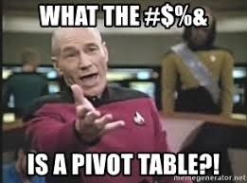
Notes:
I have been working with databases since 1997. Started out with Access before moving on to SQL Server in late 1999.
My primary tasks have been to create and optimize queries. However, I do have some experience with DTM/SSIS, Jobs, and SSRS

Slide 4
Super Technical Definition
A pivot table is a statistics tool that summarizes and reorganizes selected columns and rows of data in a spreadsheet or database table to obtain a desired report.
The tool does not actually change the spreadsheet or database itself, it simply “pivots” or turns the data to view it from different perspectives.

Slide 5
Super Simplified Definition
Pivots allow you to aggregate data while rotating rows into columns.
There are three elements to a pivot:
Grouping on rows
Aggregate function
Spreading on columns

Slide 6
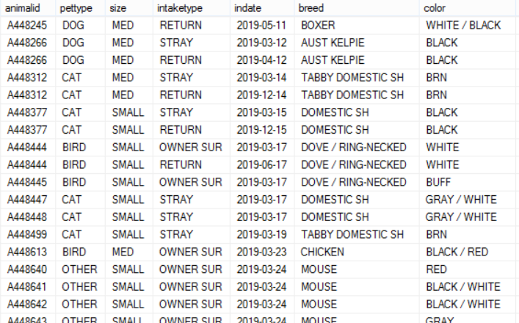
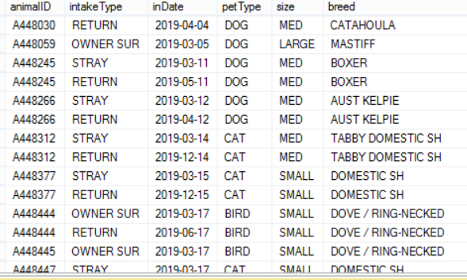
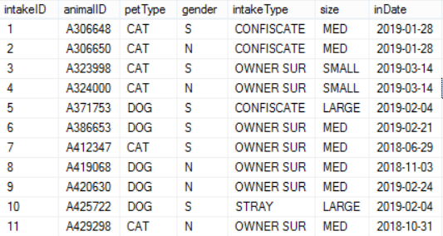
Sample Data
*Not shown is the unique intakeID field as well as other table fields

Slide 7
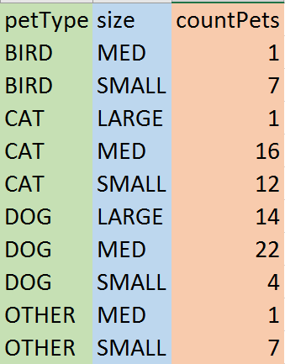
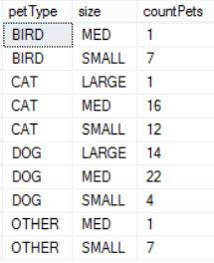
Subtotaled Data

Slide 8
Subtotaled Data

Slide 9
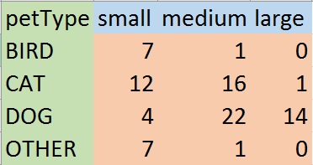
Simple Pivot Table

Slide 10
So, that’s a pivot!
Remember the three elements to a pivot
Grouping on rows
Field values to be summarized on a single line
(pet type)
Aggregate function
MIN, MAX, SUM, COUNT, AVG
(count on animal id)
Spreading on columns
Field values/categories for each aggregate
(sizes)

Slide 11
Grouping on Rows

Slide 12
Aggregate Function
Aggregate function
MIN, MAX, SUM, COUNT, AVG

Slide 13
Spreading on Columns

Slide 14
Technical Pivot Syntax
/*MAIN QUERY*/
SELECT
<non-pivoted column>
, [first pivoted column] AS <column name>
, [second pivoted column] AS <column name>
, ... [last pivoted column] AS <column name>
FROM
(
<SELECT query that produces the data>
) AS <alias for the source query>
PIVOT
(
<aggregation function>(<column being aggregated>)
FOR [<column that contains the values that will become column headers>] IN (
[first pivoted column]
, [second pivoted column]
, ... [last pivoted column])
) AS <alias for the pivot table>
<optional ORDER BY clause>;
*Not all PIVOT queries will use an asterisks in the main query, but for simplicity sake, it is ok to do.

Slide 15
SQL Server
/*MAIN QUERY
using an asterisk in this simple situation is acceptable as it will only return those fields specified below
*/
SELECT * FROM
(
SELECT DISTINCT
ai.petType /*grouping*/
,ai.AnimalId /*aggregate*/
,ai.size /*spreading*/
FROM
dbo.AnimalIntake ai
) src
PIVOT
(
COUNT(AnimalId)
FOR size IN(small, medium, large)
/*use a bracket [ ] if values contain a space or special character*/
) pvt;

Slide 16
Oracle
/*The only difference in synatx is in the “FOR <field> IN(values)” section of the PIVOT operator*/
/*MAIN QUERY*/
SELECT * FROM
(
SELECT DISTINCT
ai.petType /*grouping*/
,ai.AnimalId /*aggregate*/
,ai.size /*spreading*/
FROM
dbo.AnimalIntake ai
) src
PIVOT
(
COUNT(AnimalId)
FOR size IN(‘SMALL‘ AS small, ‘MED’ AS med, ‘LARGE’ AS large)
) pvt
;

Slide 17
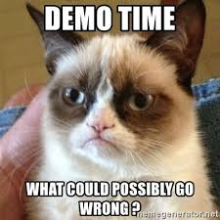

Slide 18


Slide 19
But Wait. There’s More!
Sometimes the customer wants multiple data points aggregated.
For example:
Your customer wants to see the number of pet size AND type of animal intake per animal type.
Enter … the Multi Pivot

Slide 20


Slide 21
But Wait. There’s More!
Manual and PIVOT operators rely on knowing what values to aggregate and pivot.
This is not always the case.
Enter … the Dynamic Pivot
Your customer wants to see the most recent intake of each breed.

Slide 22


Slide 23


Slide 24
Resources
AppDev Presentation:
… Become a T-SQL Pivoting Ninja in 60 Minutes Or Less
… by Peter Doyle on Feb 22nd @9am;
… Registration at: https://appdev.pass.org/
Dynamic PIVOT Resources
Aaron Bertrand
dynamic pivot (10-16-2016) https://www.mssqltips.com/sqlservertip/2783/script-to-create-dynamic-pivot-queries-in-sql-server/
Eli Leiba
stored procedure: https://www.mssqltips.com/sqlservertip/6245/sql-server-dynamic-pivot-query/

Slide 25
Thank You!
Sponsors for your support. Without it, these meetings would not be possible
Ray Barley for organizing Baltimore SQL Server User Group meetings and giving me the opportunity to speak with you today
Attendees for your time and questions

Slide 26

Peg LeDell
Query Performance Tuning Ninja, SQL Saturday Groupie, and Firefly Fan
Contact information:
Peg@SerenityCreations.net
GitHub: https://github.com/serenitysql/PIVOT
Website: http://serenitycreations.net/

